Slide 1
MOBILE APP PROGRAMMING Personal Project 2016312761 Yeo Hyuksoo

Slide 2
APPLICATION SUBJECT & DEMONSTRATION
APP NAME: Daanawa
SUBJECT: COMPUTER SHOPPING!
Demonstration : You can estimate your computer by choosing several pieces of computer in market page. If you want some of pieces of computer, you can insert some in your bucket. Finally you can buy your computer and get your receipt in Kakaotalk!

Slide 3
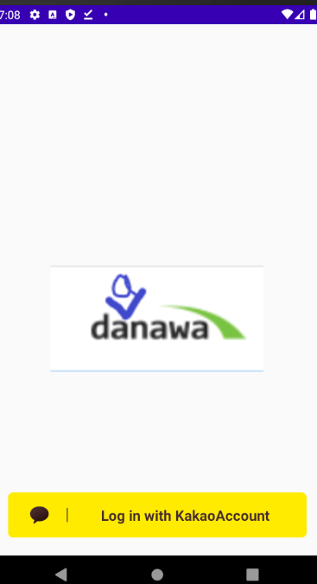
LOGIN PAGE
You can login by your Kaka otalk account.

Slide 4
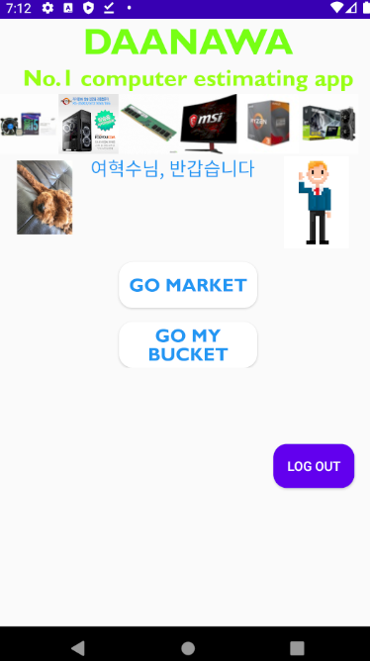
HOME PAGE
You can see your profile image, name. And you can choose menu composed of Go market, and Go my bucket.

Slide 5
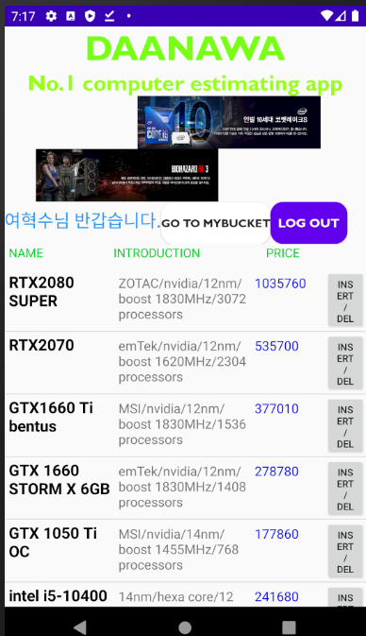
MARKET PAGE
You can making your own computer by putting some in your bucket. You can go to bucket page or logout.

Slide 6
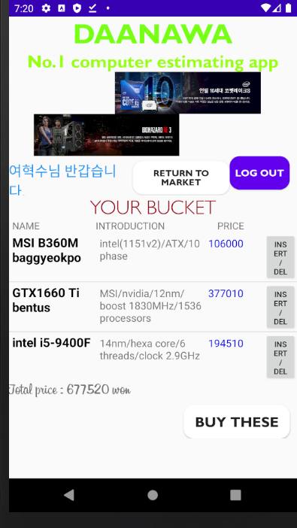
BUCKET PAGE
You can check your bucket before you decide to buy. Also you can see total price of your computer. You can go back to market page, or logout.

Slide 7
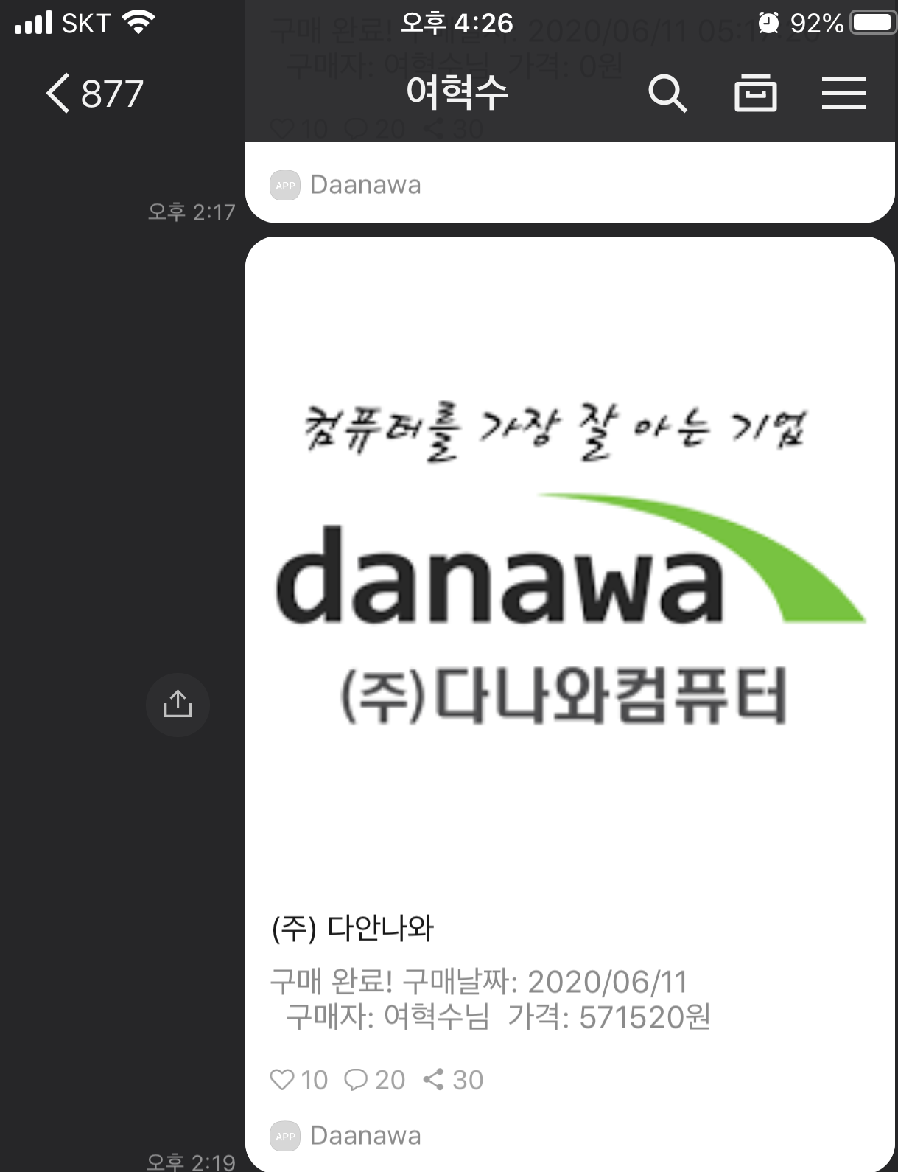
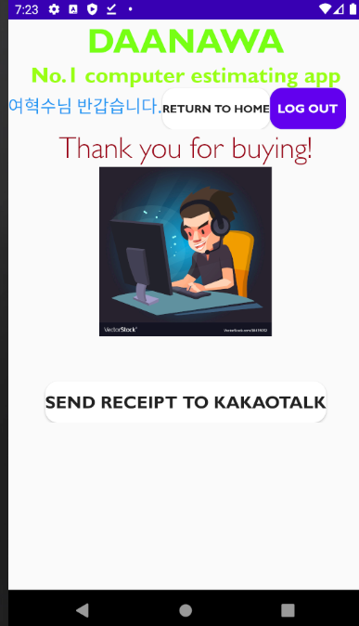
BUY PAGE
If you click “BUY THESE” in bucket page, you can see page like this. You can send receipt to your Kakaotalk account. And you can go back to home page or logout.

Slide 8
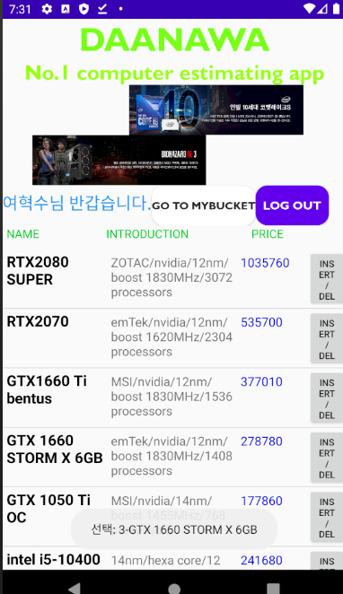
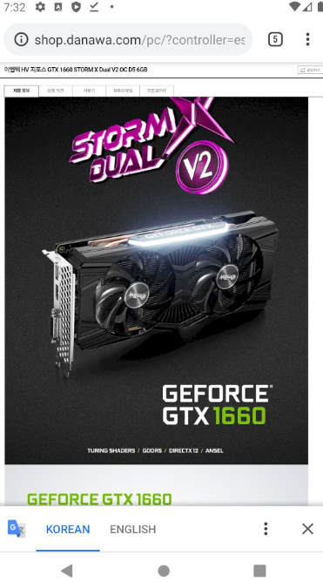
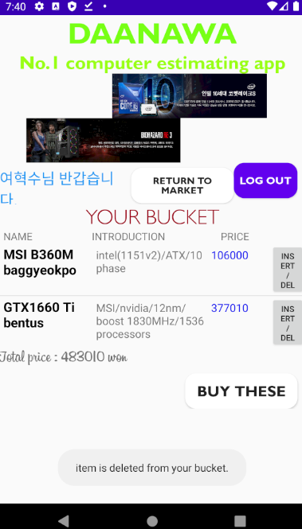
CHALLENGE
After click name
If you want more introduction or reviews of product, click the name of product.
toast
If you click button, item will be deleted from your bucket and disappeared. total price will be changed accordingly.
Total price
changed

Slide 9
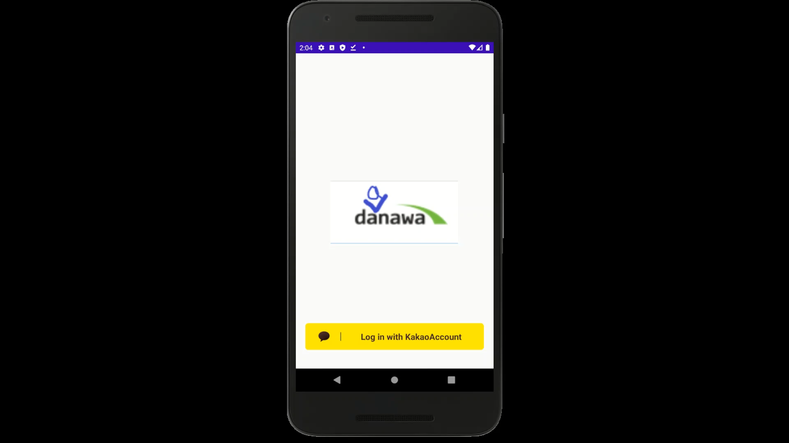

Slide 10
THANKS!
ANY QUESTIONS?
2016312761 Yeo hyuksoo

